Slide 1

Integrated Multi-Omics Data Analysis
Gene Ontology & HPO Visualization via MOFA
Matteo Calloni – Daniel Simontacchi

Slide 2
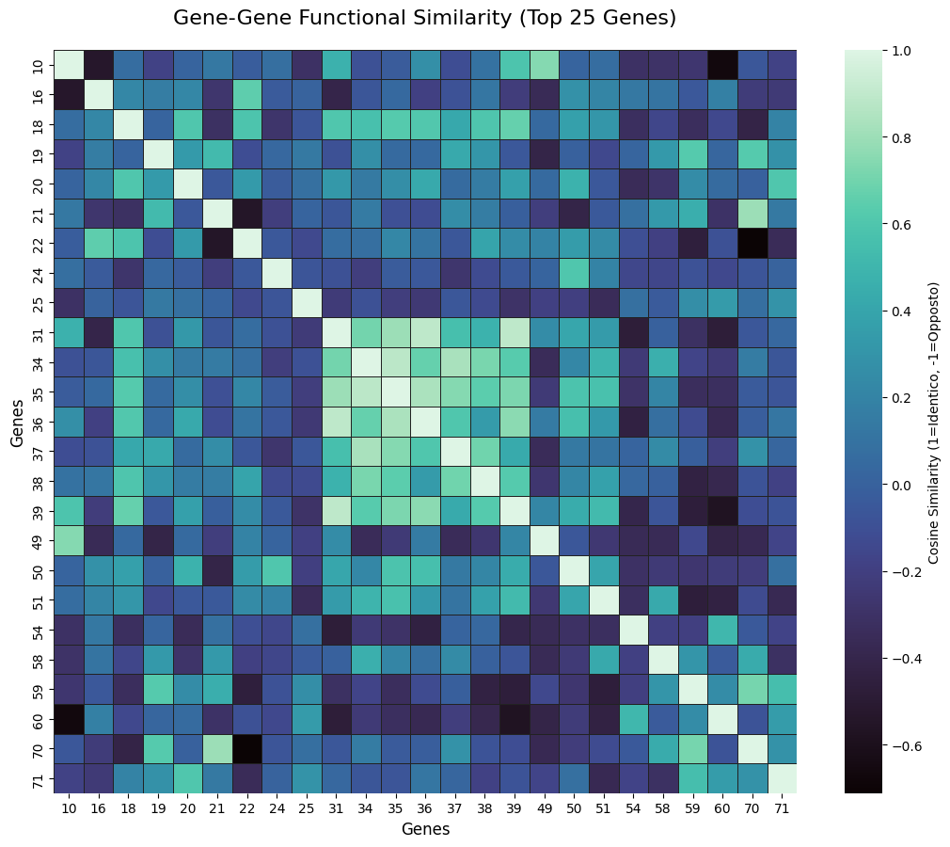
Correlation Structure: The visible "block" structure indicates groups of genes working closely together.

Slide 3
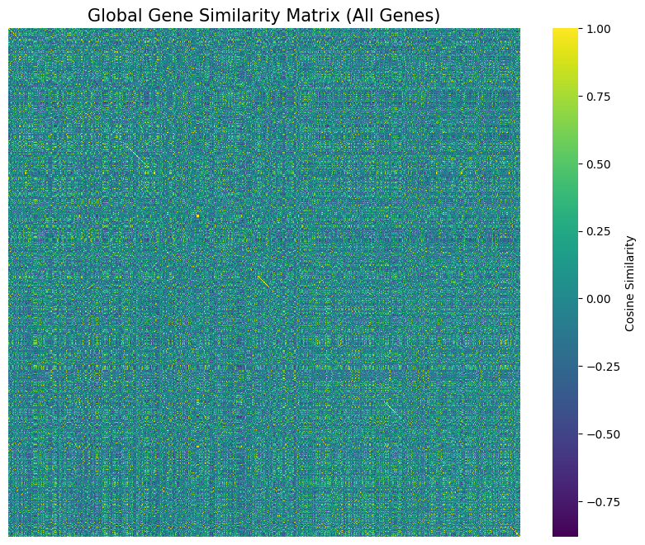
Sparsity: Most genes do not interact (dark areas), highlighting that the biological signal comes from specific functional modules.

Slide 4
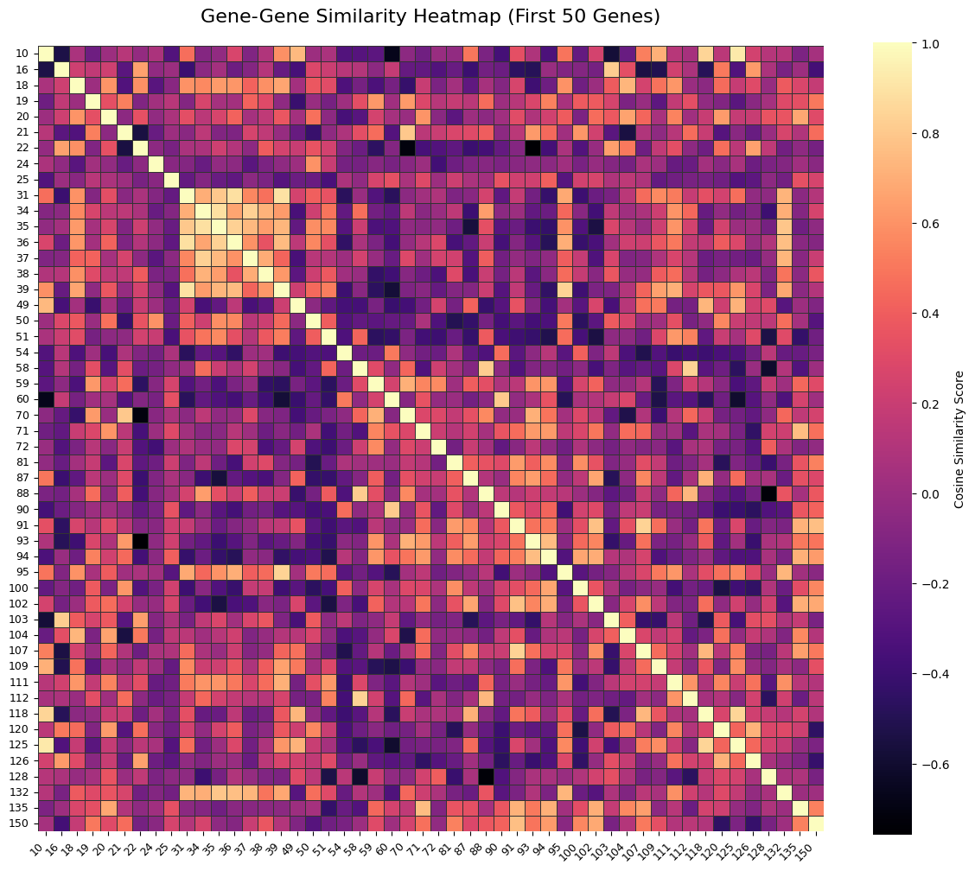
Insight: The analysis confirms strong local signals, making the dataset suitable for Factor Analysis.

Slide 5
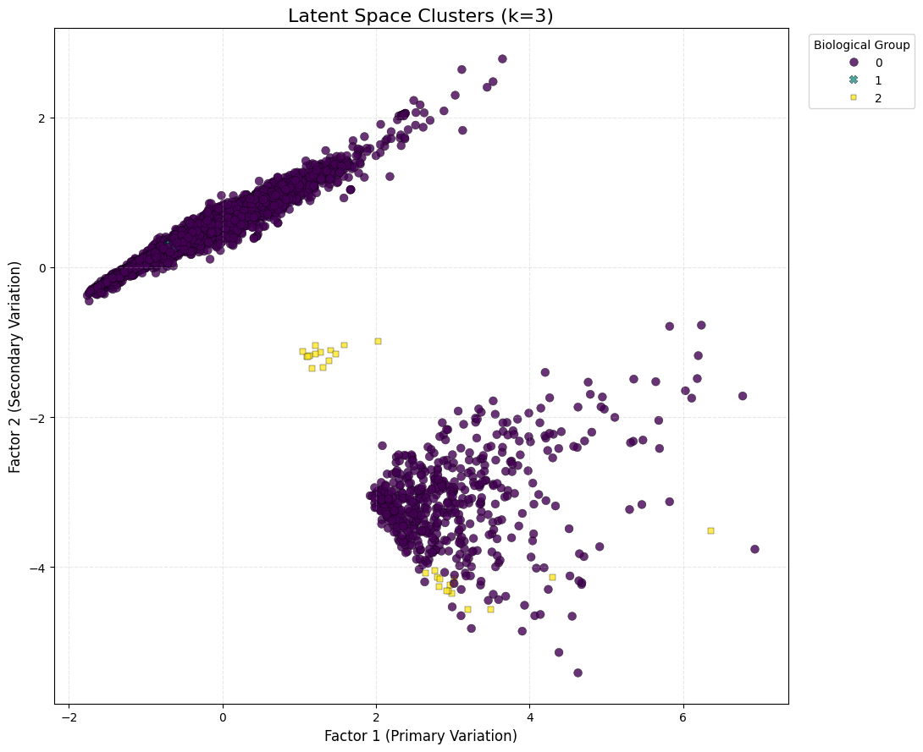
Dimensionality Reduction: Compressing thousands of features into 2 Latent Factors. The V-Shape: Indicates a continuous biological gradient rather than discrete buckets. Outliers: The yellow points represent a distinct sub-population of genes with unique properties.

Slide 6
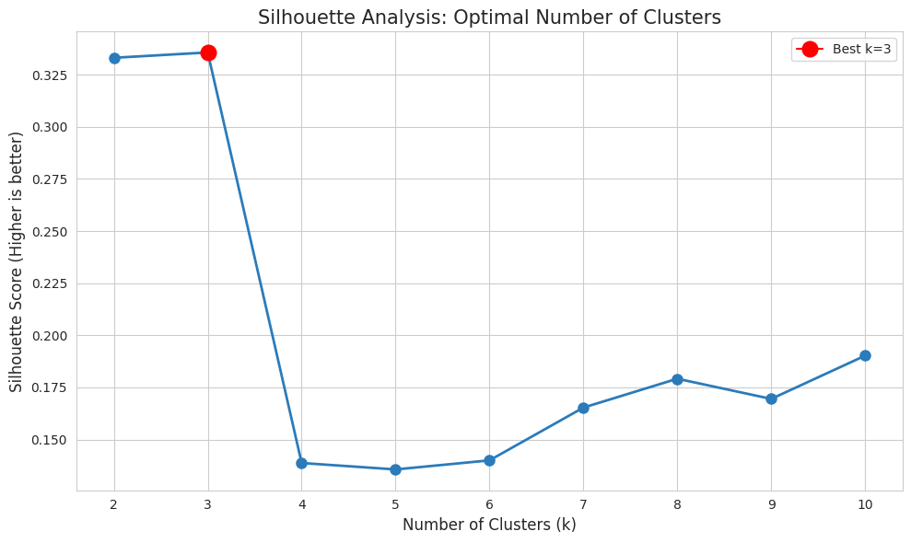
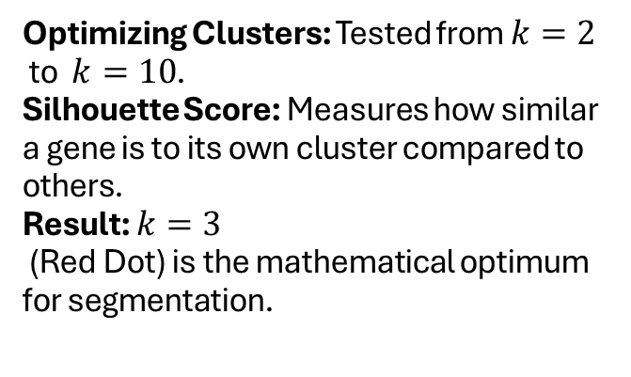
Optimizing Clusters: Tested from $k=2$ to $k=10$. Silhouette Score: Measures how similar a gene is to its own cluster compared to others. Result: $k=3$ (Red Dot) is the mathematical optimum for segmentation.

Slide 7
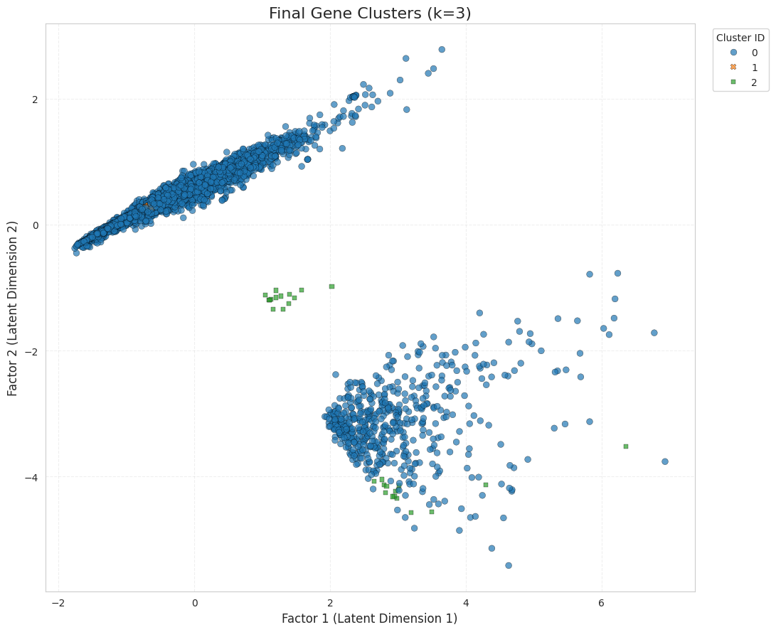
Segmentation: Three distinct biological behaviors identified. Cluster 0 (Blue): The "Core" biological functions (largest group). Cluster 1 & 2: Specialized gene sets with distinct profiles. Insight: Clear separation suggests distinct functional roles in the dataset.

Slide 8
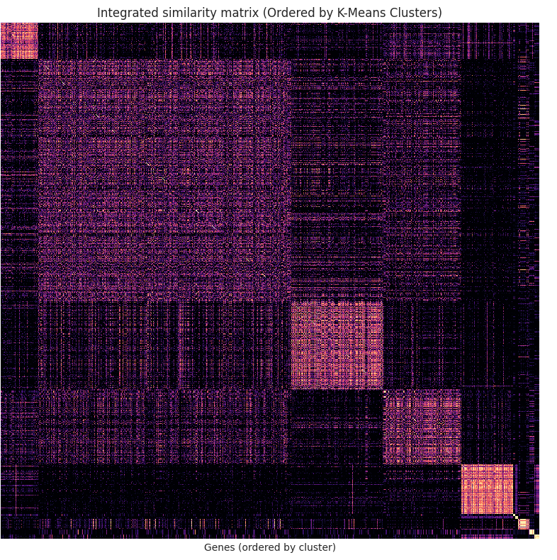
Validation: Sorting the similarity matrix by our K-Means clusters reveals dense squares along the diagonal, confirming strong cluster cohesion.

Slide 9
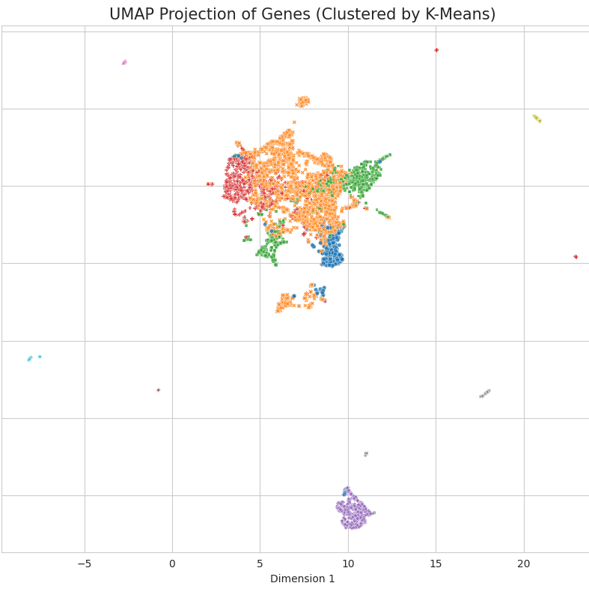
Consistency: The UMAP projection confirms that the 3 clusters remain distinct and well-separated even in non-linear space.

Slide 10
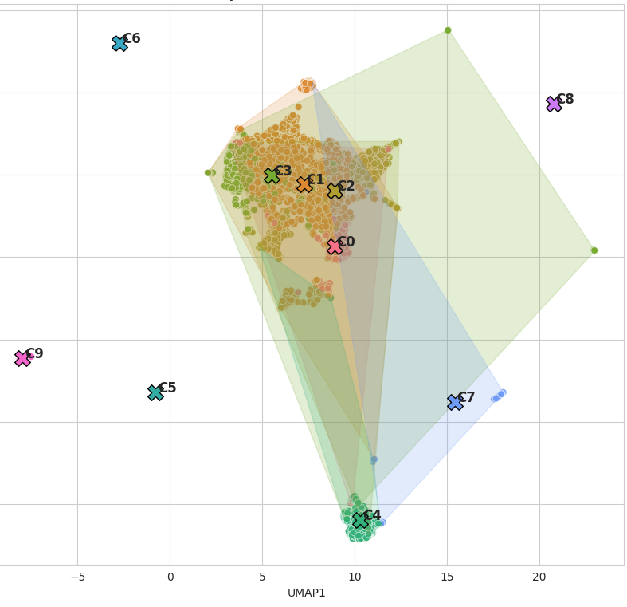
Cluster Topology & Boundaries Boundaries: Defining the "territory" of each gene cluster. Overlap: Minimal overlap between Cluster 1 and Cluster 3 indicates distinct biological pathways. Spatial Logic: Genes with similar functions map to the same geometric region.

Slide 11
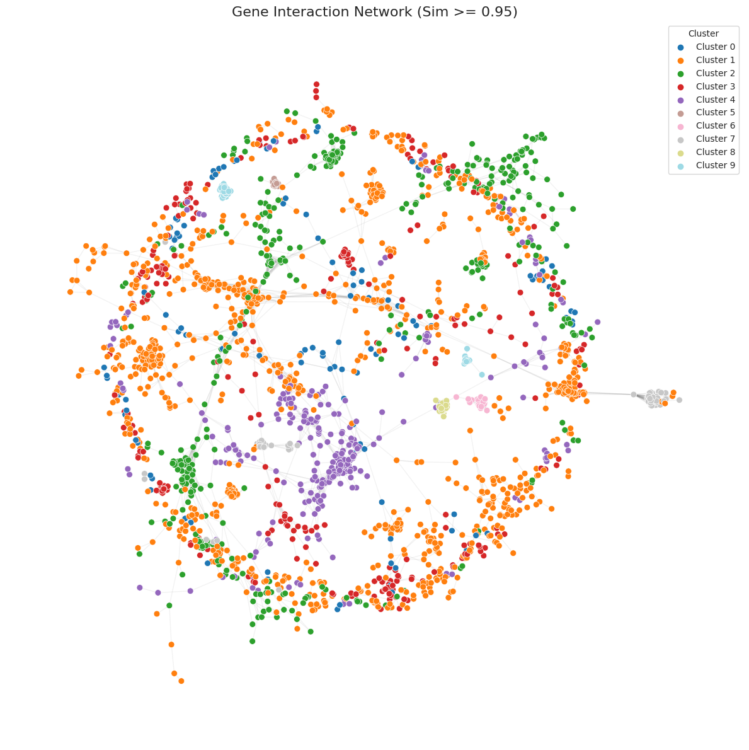
Connectivity: The global gene interaction network naturally breaks into distinct biological modules rather than a single chaotic mess.

Slide 12
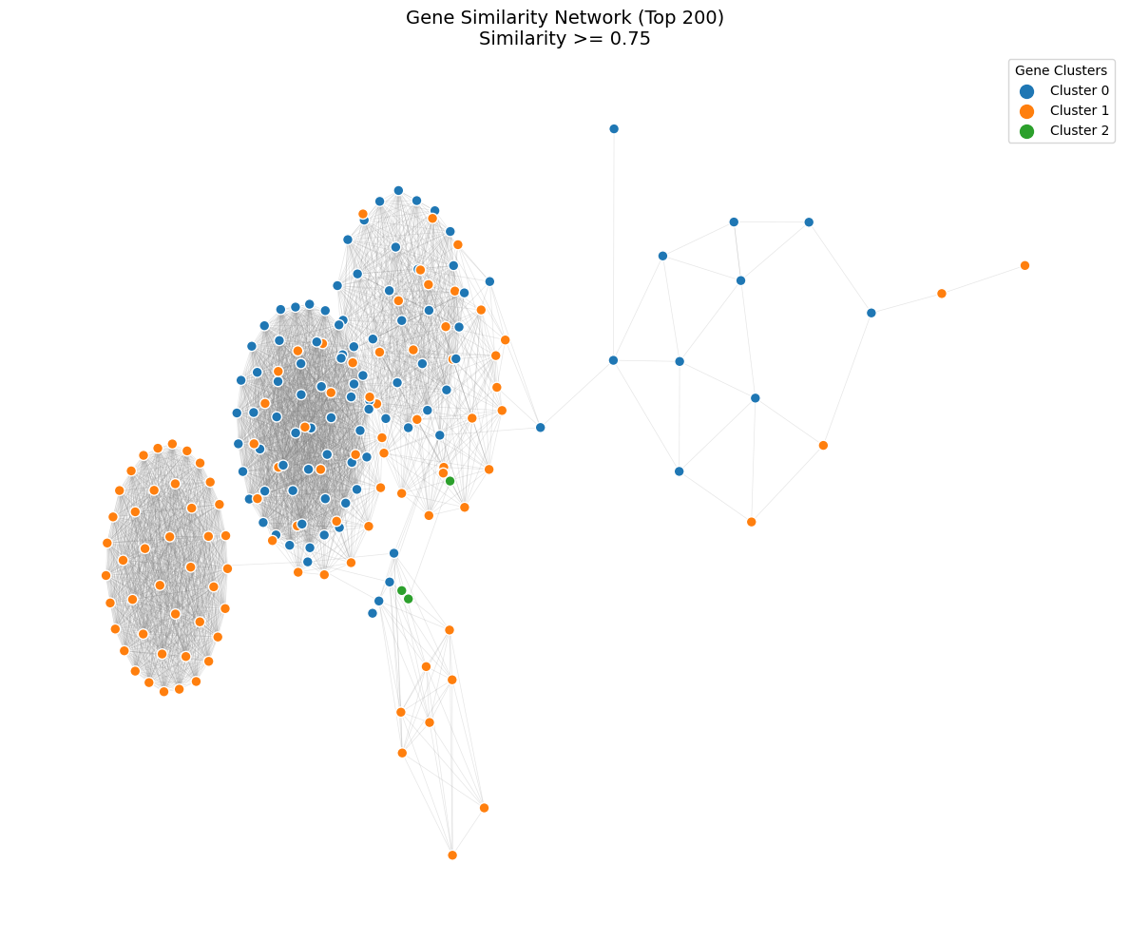
Modules: Zooming into the strongest 200 interactions reveals clear separation between the three main gene groups.

Slide 13
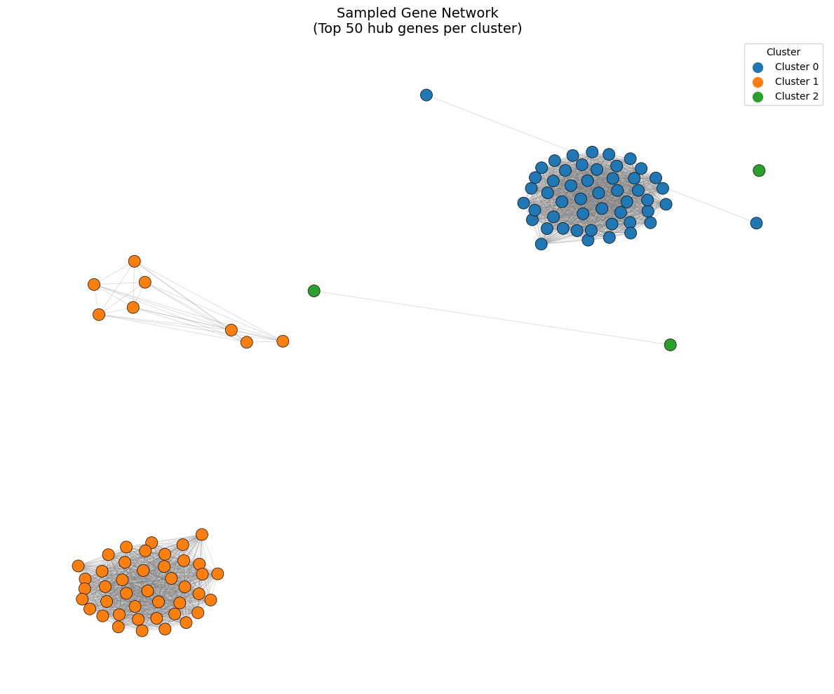
Hub Genes: We identified a few key genes acting as "bridges" or hubs, essential for connecting different biological processes.

Slide 14
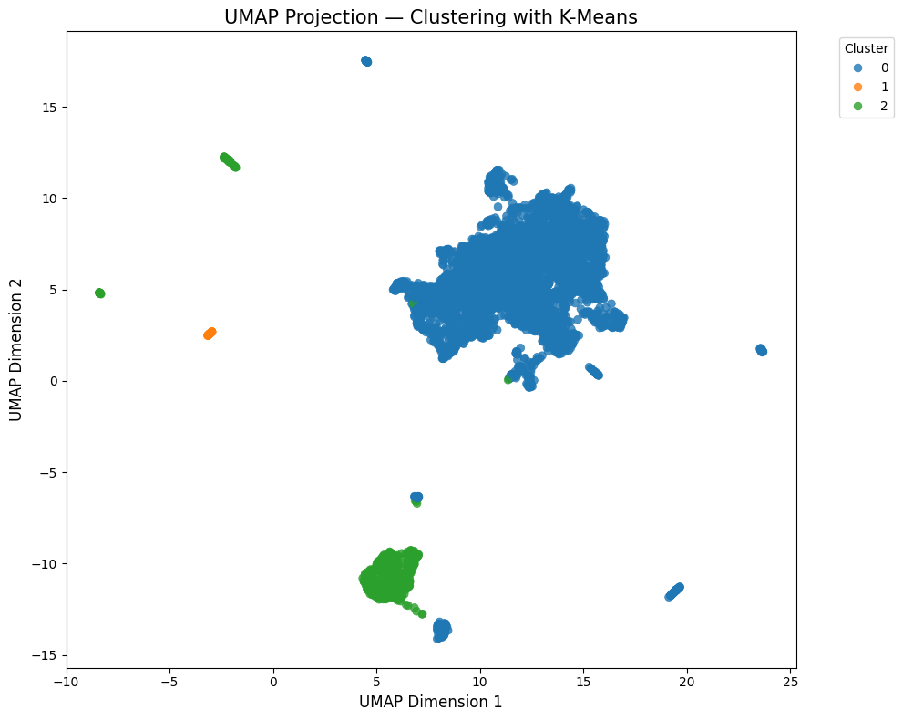
Cluster Definition: The visualization clearly shows how K-Means partitions the continuous Latent Space into three distinct "islands" of genes. Separation: The empty space between the Blue, Green, and Orange groups indicates significant biological differences.

Slide 15
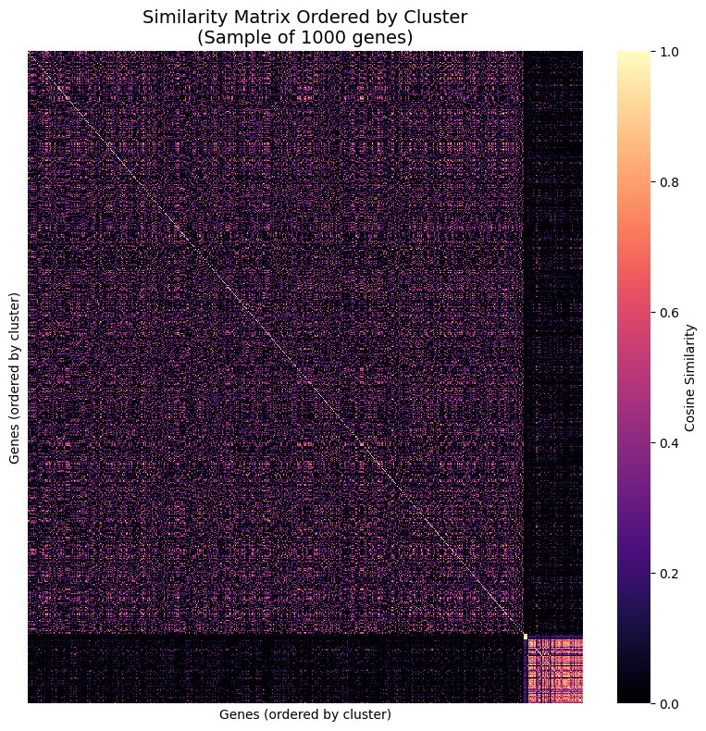
Sample Validation: Even when analyzing a smaller random subset (1,000 genes), the diagonal structure remains sharp. Stability: This confirms that the patterns are robust and not just an artifact of the full dataset size.

Slide 16
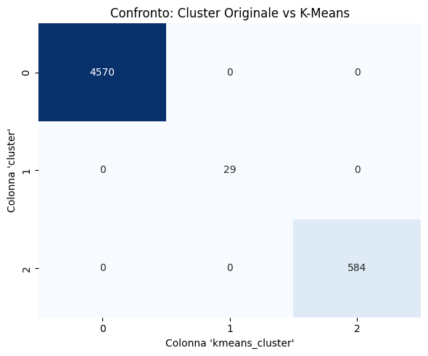
Robustness Check: We compared our K-Means results against Spectral Clustering to ensure the validity of our segmentation.

Slide 17
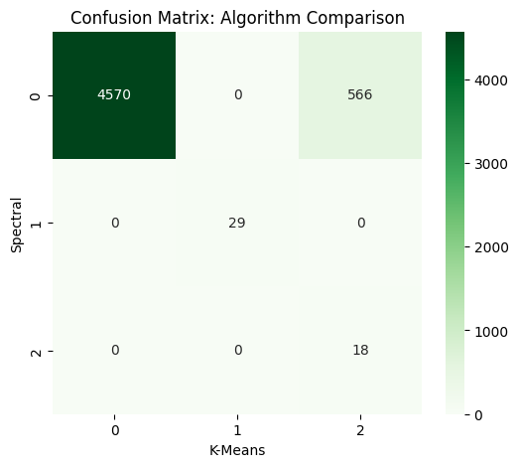
Agreement: The diagonal dominance indicates >95% agreement between algorithms, proving the clusters are stable.

Slide 18
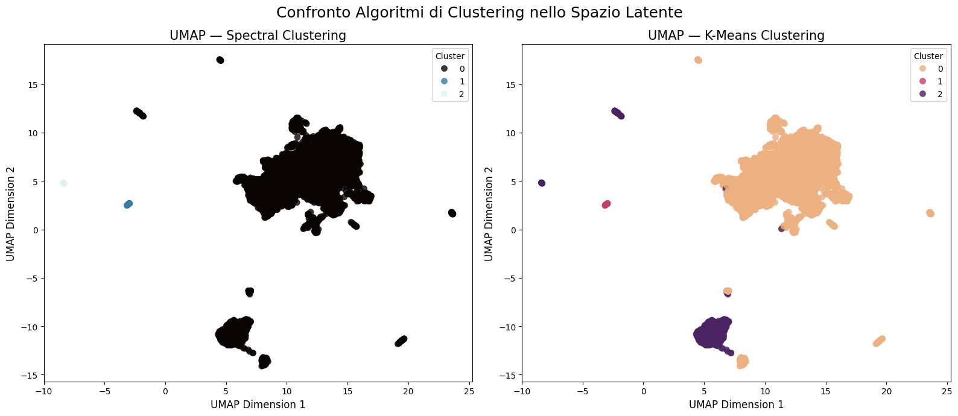
Conclusion: Visually, the clusters overlap perfectly. The biological groups are real, not artifacts of a specific algorithm.

Slide 19
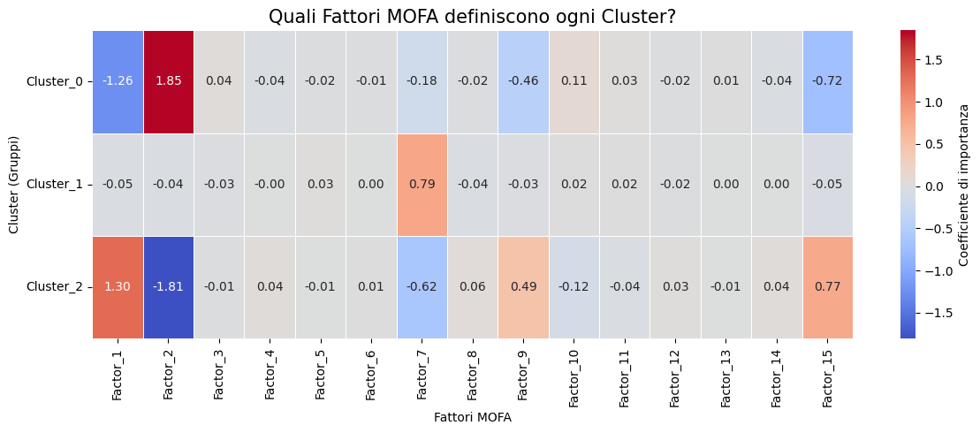
The "DNA" of Clusters: Which MOFA Factor defines each group? Cluster 0: Strongly driven by Factor 2 (Positive, Red). Cluster 2: Strongly driven by Factor 2 (Negative, Blue) and Factor 15. Insight: Factor 2 is the main discriminator between the two largest gene groups.

Slide 20
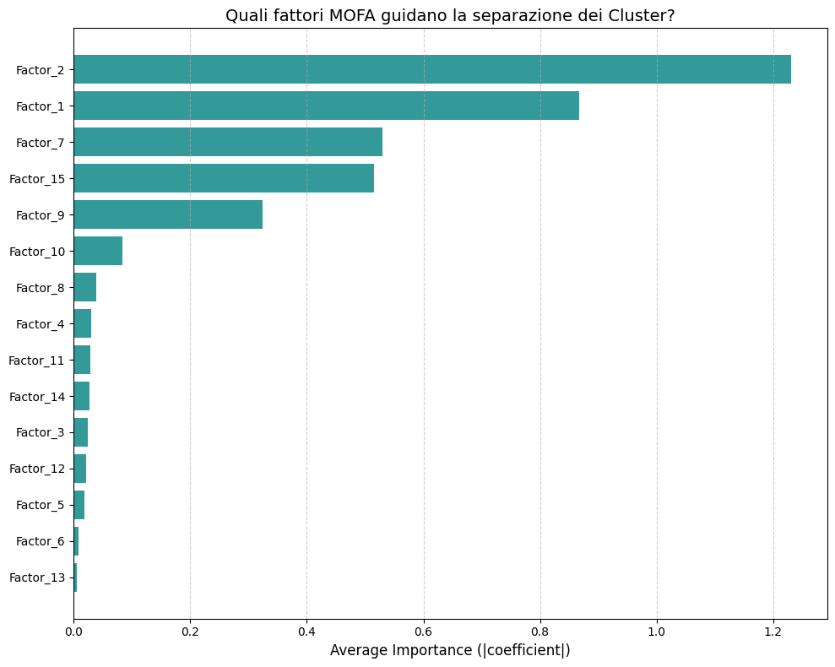
Key Drivers: Factor 1 and Factor 2 capture the most variance overall, acting as the main "engines" of the model.

Slide 21
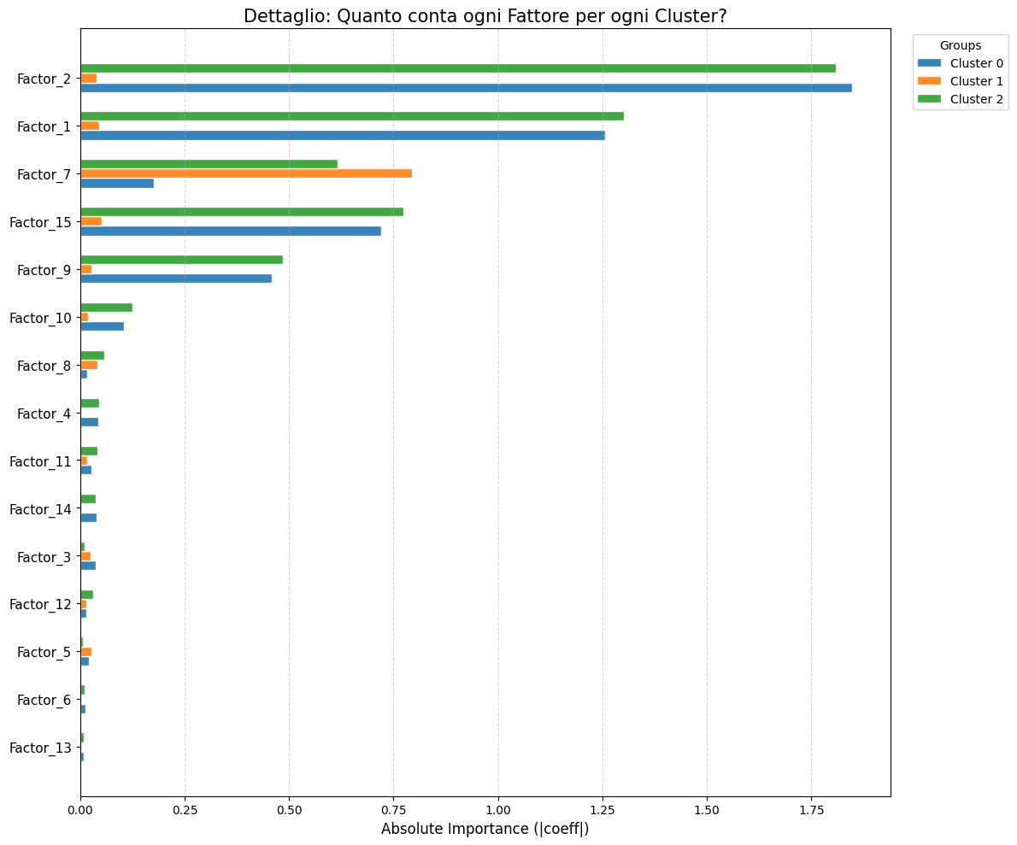
Cluster Specificity: Breaking it down by cluster reveals that Factor 7 is the unique signature defining the specific Cluster 1 (Green).

Slide 22
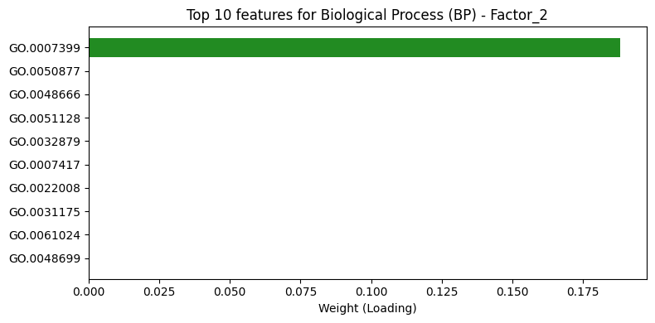
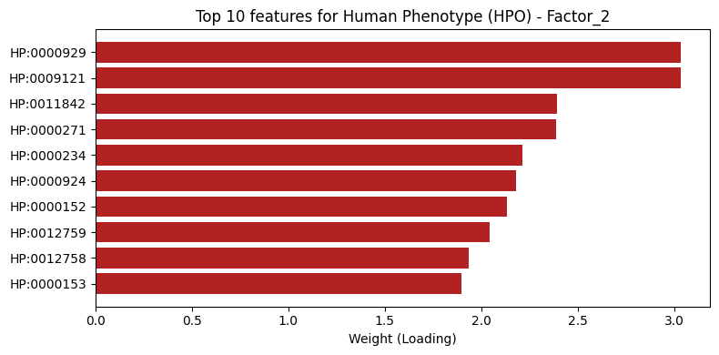
Decoding Factor 2: This factor is strongly associated with specific metabolic processes (BP) and severe phenotypic abnormalities (HPO).

Slide 23
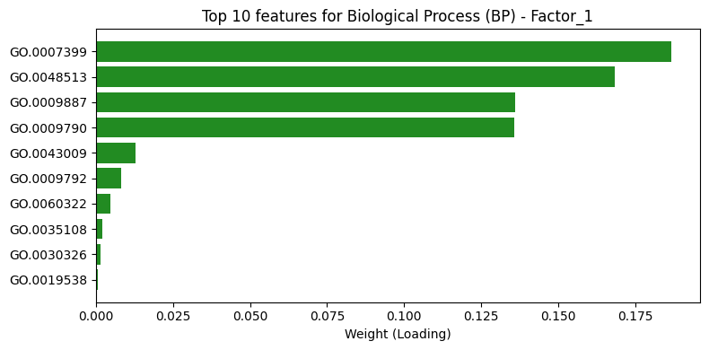
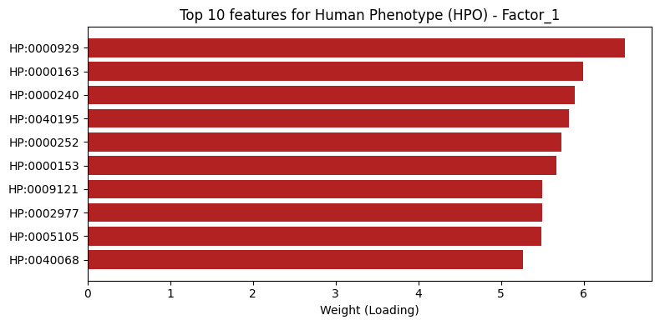
Decoding Factor 1: Represents a broader set of general cellular components, acting as a baseline for gene function.

Slide 24
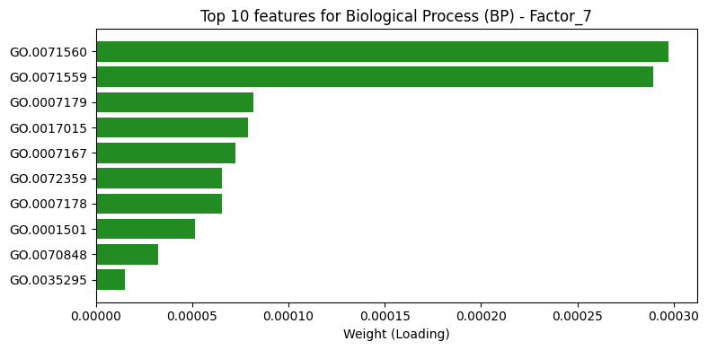
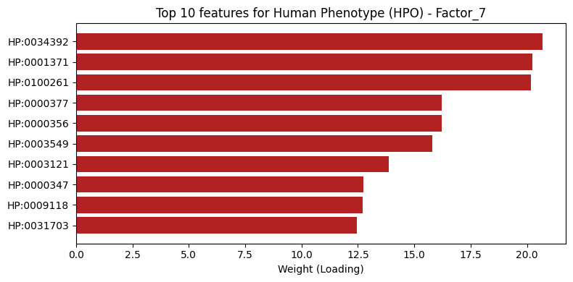
Insight: Factor 7 contains very specific terms that isolate the small "Cluster 1" population from the rest of the genes.

Slide 25
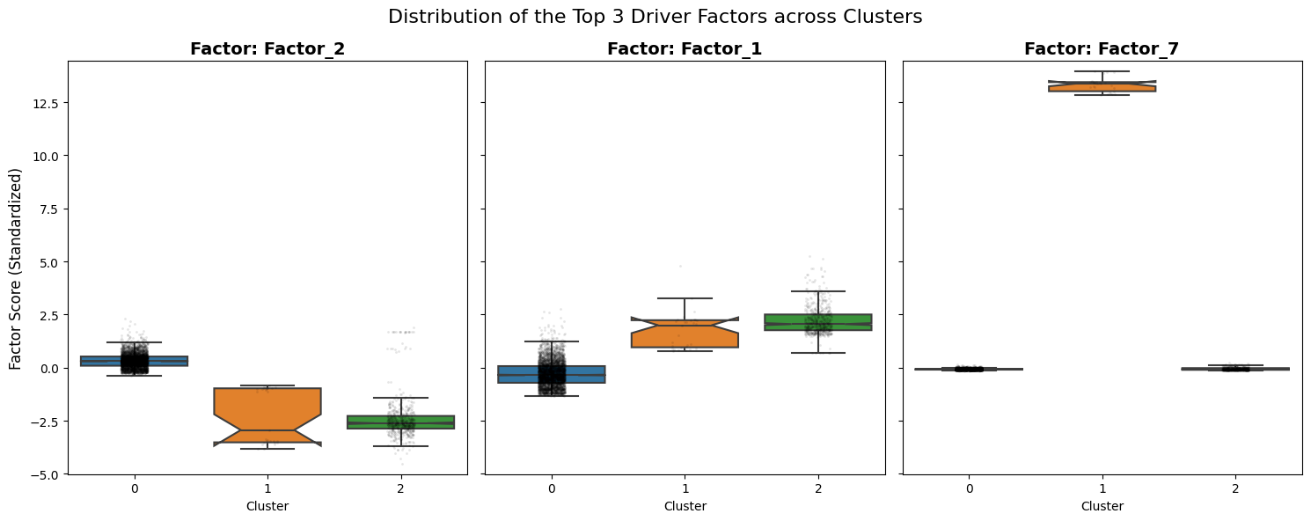
Statistical Proof: The clusters have significantly different distributions for Factor 1 and 2. Separation: Factor 7 acts as a specific marker for the smaller Cluster 1. Conclusion: The MOFA model successfully disentangled the complex biological signals.

